Slide 1
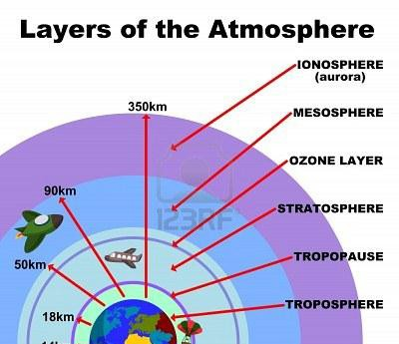
Antenna and Wave Propagation (Chapter Seven)
Communication Dep. 3rd Stage Asst. Lect. Jinan N. Shihab
Diyala University Engineering Collage
Atmosphere:-
In earth's environment, EM waves propagate in space that not only depend on their own properties but also dictated by the environment itself. The atmosphere consists of layers of air that surround the Earth. Some of the “air” is oxygen, which we breathe, but there are also many other gasses, dust particles, and even some water vapor mixed into the air, as shown in the following figure:-
As the medium between transmitting and receiving antennas play an important role, it is necessary to study the medium above the earth. It's include:-
1- Structure of Troposphere:-
Almost all weather phenomena take place in the troposphere. The temperature in this region decreases rapidly with altitude. Clouds form, and there may be a lot of turbulence because of variations in the temperature, pressure, and density. These conditions have a profound effect on the propagation of radio waves.
This is the layer of the atmosphere closest to the Earth's surface, extending up to about 10-15 km above the Earth's surface.
There is a thin buffer zone between the troposphere and the next layer called the tropopause. And tropopause ends at the beginning of stratopause.
The troposphere begins at the surface and extends to between 7 Km at the poles and 18 Km at the equator.
The conductivity of troposphere region is σ=0. The relative permeability μr =1 (non-
magnetic medium).

Slide 2
Antenna and Wave Propagation (Chapter Seven)
Communication Dep. 3rd Stage Asst. Lect. Jinan N. Shihab
Diyala University Engineering Collage
2- The Stratosphere and Ozone Layer:-
❖ This layer lies directly above the troposphere and is about 35 Km deep. It extends from about 15 to 50 Km above the earth's surface. It is located between the troposphere and the ionosphere.
❖ The temperature throughout this region is almost constant and there is little water vapor present. Because it is a relatively calm region with little or no temperature change, the stratosphere has almost no effect on radio waves.
❖ The Ozone Layer: The stratosphere contains a thin layer of ozone molecules (with three oxygen atoms) which forms a protective layer shielding life on Earth from the Sun’s harmful ultraviolet radiation.
The Structure of Mesosphere:-
✓Directly above the stratosphere, extending from 50 to 80 km above the Earth's surface.
  The mesosphere is a cold layer where the temperature generally decreases with increasing altitude.
✓Here in the mesosphere, the atmosphere is very rarefied nevertheless thick enough to slow down meteors hurtling into the atmosphere, where they burn up, leaving fiery trails in the night sky.
4- The Structure of Ionosphere (Thermosphere):-
The thermosphere extends from (50-400) km above the Earth's surface to outer space.
The temperature is hot and may be as high as thousands of degrees as the few molecules that are present in the thermosphere receive extraordinary large amounts of energy from the Sun.
It is distinguished because it is ionized ( ionization is produced from the sun (ultra violet radiation, β, α rays) by solar radiation, the ionized region so consists of free electrons, positive ions and negative ions. It plays an important part in atmospheric electricity and forms the inner edge of the magnetosphere. It has practical importance because, among other functions, it influences radio propagation to distant places on the Earth.
Since ionosphere is not uniform but it distribution in layers. The high will vary from day to day, month to month and year to year. For each layer there is critical
frequency, above which if a radio wave is sent vertically upward, will not return back
to the earth but will penetrate it.
The ionosphere also attenuates radio waves. The amount of attenuation is roughly inversely proportional to the square of the frequency of the wave. Thus attenuation

Slide 3
Antenna and Wave Propagation (Chapter Seven)
Communication Dep. 3rd Stage Asst. Lect. Jinan N. Shihab
Diyala University Engineering Collage
is a several problem at lower frequency, making daytime global communication via sky wave impossible at frequency much below 5 Mhz.
There three layered D, E, F1, F2 during day time. The F1,F2 layers combines and form one layer called F, and D layer vanishes together during the night.
D layer
  The D layer ranges from about 30 to 55 miles above the earth.
  Ionization in the D layer is low because less ultraviolet light penetrates to this level.
  At very low frequencies, the D layer and the ground act as a huge waveguide, making communication possible only with large antennas and high-power transmitters. At low and medium frequencies, the D layer becomes highly absorptive, which limits the
effective daytime communication range to about 200 miles. At frequencies above about
3 MHz, the D layer begins to lose its absorptive qualities. Long-distance communication is possible at frequencies as high as 30 MHz Waves at frequencies above this range pass through the D layer but are attenuated.
  After sunset, the D layer disappears because of the rapid recombination of ions. Low- frequency and medium-frequency long-distance communication becomes possible. This is why AM behaves so differently at night. Signals passing through the D layer
normally are not absorbed but are propagated by the E and F layers.
E layer
o Occurs mainly during daylight hours and only weakly at night.
o It is located about (90 to 130) Km above ground level with a free electron density is lower in winter than summer, since the obliquity of the sun reduces the ionization
effect. It causes some bending for FM wave. It contains three main layers:
o Es – sporadic layer, small thickness (2 Km), discontinuous, altitude 90 Km, it is
capable of reflecting high frequencies than would normally be possible.
o E1- the thickness varies between (20 to 30) Km, it is maximum 120 Km altitude and critical frequency is 4 MHz
o E2- at 130 Km.
F layer
☒ It is known as the Appleton layer, it extends from (130 to 450) Km.
☒ It consist of two layers with very different patterns of behavior during the day. The lower of these is F1 and the upper is F2. Atypical variation of the free electron density
with height (h) is shown in the figure below;
☒ Since the F layer is the highest of the ionosphere layers, it also has the longest propagation capability. For horizontal waves, the single-hop F2 distance can reach
3000 miles. For signals to propagate over greater distances, multiple hops are
required. The bending of radio wave at ionosphere can readily be understood with the help of refractive index of ionosphere formula of the ionized medium:-

Slide 4
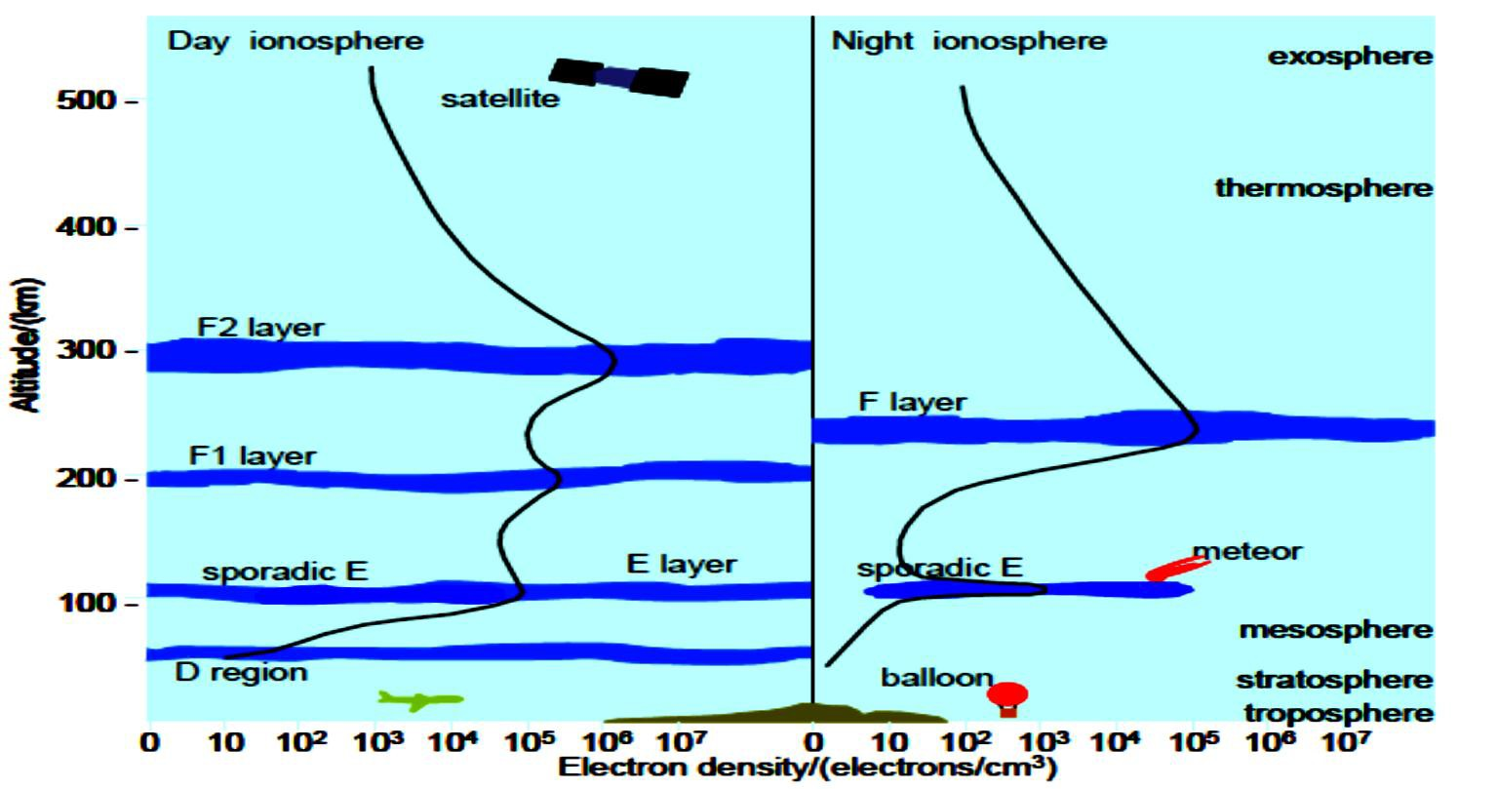
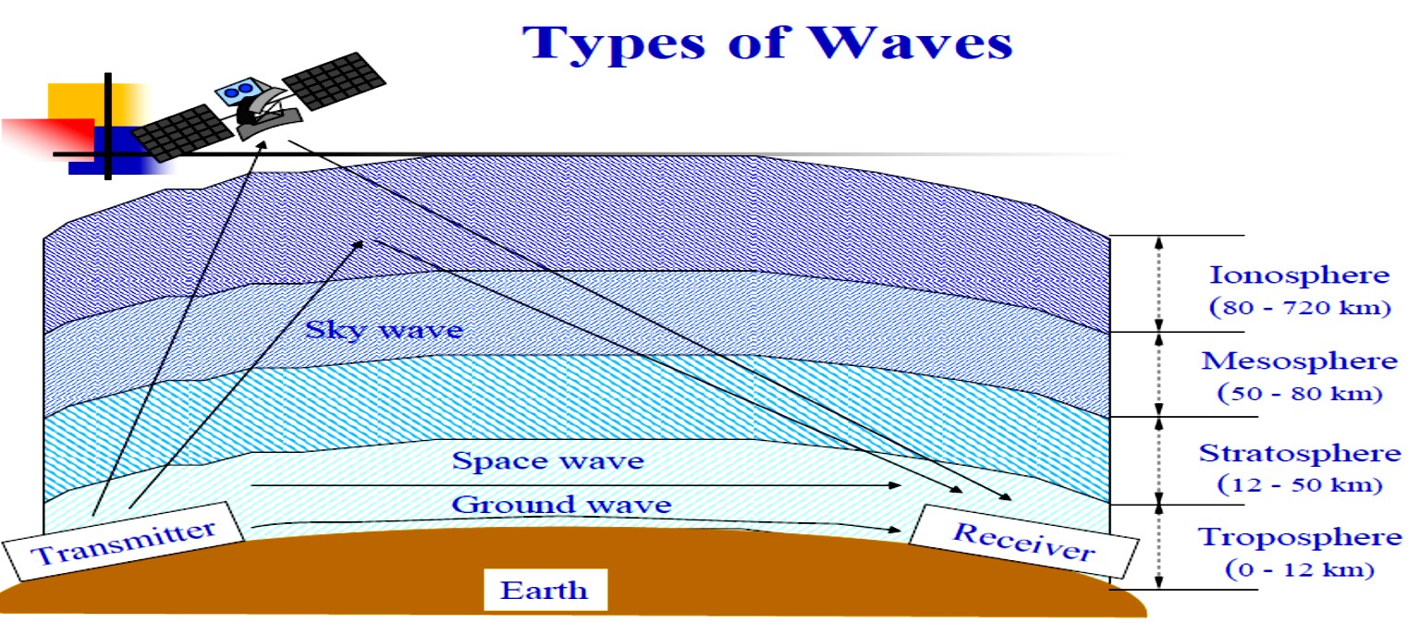
Antenna and Wave Propagation (Chapter Seven)
Communication Dep. 3rd Stage Asst. Lect. Jinan N. Shihab
Diyala University Engineering Collage
𝒓= √𝒌_{𝒓}= √� −
��𝑵
��
Where:-
N is the number of electron per cubic meter or ionic density (in m³) .
f is the frequency in Hz. If N is in per cubic cm the frequency is in KHz.
If f² < 81N = ref. index becomes imaginary ( it means under such condition the R.W are attenuated at this frequency and ionosphere is not able to transmit or bend the R.W).
Modes of Propagation:-
The radio waves from Tx antenna may reach to Rx. antenna using any of the following modes of propagation depending on the factors like:-
Frequency of operation.
Distance between Tx and Rx antenna.

Slide 5
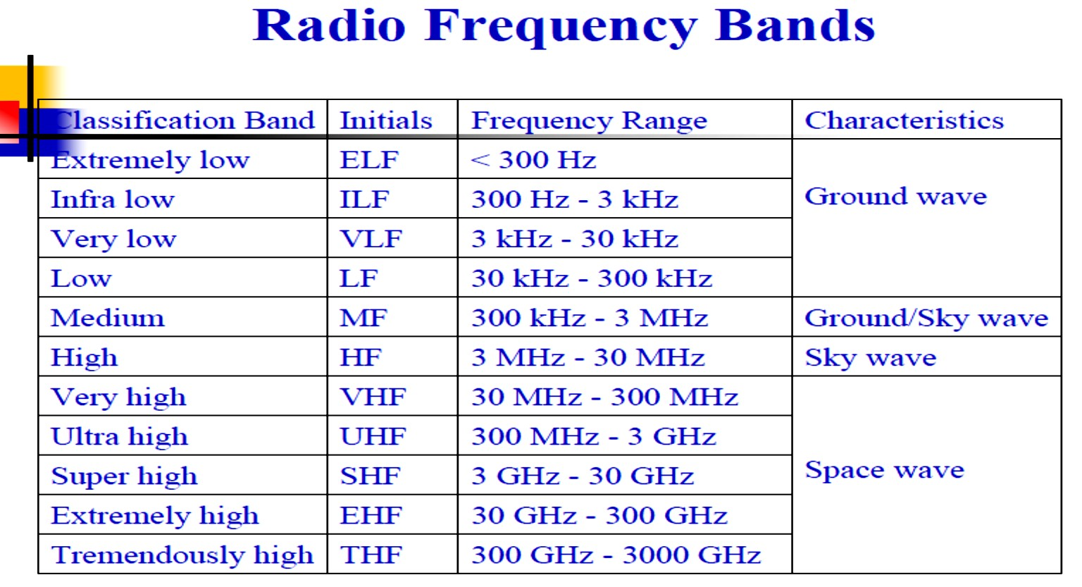
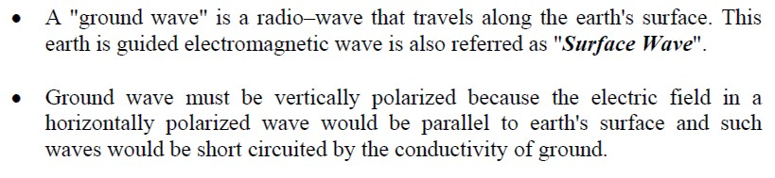
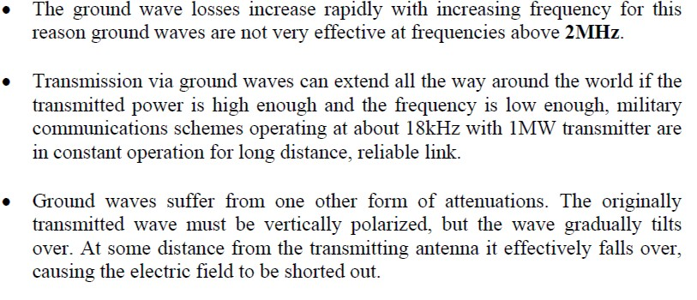
Antenna and Wave Propagation (Chapter Seven)
Communication Dep. 3rd Stage Asst. Lect. Jinan N. Shihab
Diyala University Engineering Collage
1- Ground Wave Or Surface Wave Propagation (Up To 2 Mhz):-
Ground wave propagation operates mainly in the three frequency bands, VLF, LF, MF (3 KHz -2 MHz). VLF is restricted to low rate telegraphy and narrowband

Slide 6
Antenna and Wave Propagation (Chapter Seven)
Communication Dep. 3rd Stage Asst. Lect. Jinan N. Shihab
Diyala University Engineering Collage
navigation techniques. While LF and MF can be used for radio broadcasting and communication as well as navigation aids. This mode of propagation suffers varying amount of attenuation while propagation along curvature of earth, depending upon frequency surface irregularities, permittivity and conductivity. At high frequency attenuation by ground is more than at low frequency over same ground
These waves are guided by the conducting surface of the earth, along which they are propagated.
Maximum rang depends on frequency and power:-
Field strength:-
��� 𝝅�_{𝒕}�_{𝒓}𝑰 𝑬= 𝑽/𝒎 𝝀�
 | 𝑬� = | 𝑬𝑨
 |  | 𝒅
For flat earth
�
Short vertical unipole antenna, E0 conductiong earth is:-
at distance on a hypothetical flat perfectly
𝑬� =
√��𝑷
𝑽/𝒎
𝒅
Ground wave attenuation factor:- 𝑨=
�+�.�𝑷
�+𝑷+�.𝟔𝑷�
Where :-
ht and hr the the hight of Txand Rx.
P represented power radiation from transmitting antenna.
d distance between Txand Rx.
2- Sky Wave Or Ionospheric Wave Propagation (Between 2-30 Mhz):-
The sky waves are having practical important at medium and high frequencies (MH and HF) for very long distance radio communication.
EM reaches the Rx point after reflection from ionized region in upper atmosphere called ionosphere ( ionosphere acts as reflecting surfaces). It is able to reflect back the EM waves of frequencies between (2-30) MHz. EM more than 30 MHz frequency are not reflected back from ionosphere.
Sky waves propagation called ionosphere propagation or short wave propagation.
Extremely long distance round communication is also possible by multiple reflection of sky waves. As in a single reflection from the ionosphere the radio waves cover a distance not more than 4000 Km

Slide 7
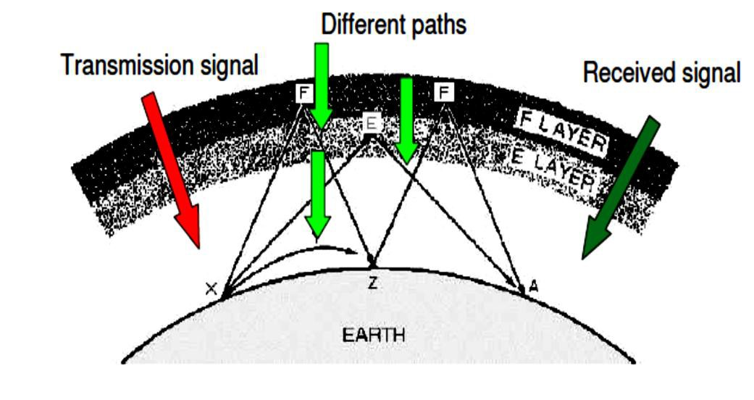
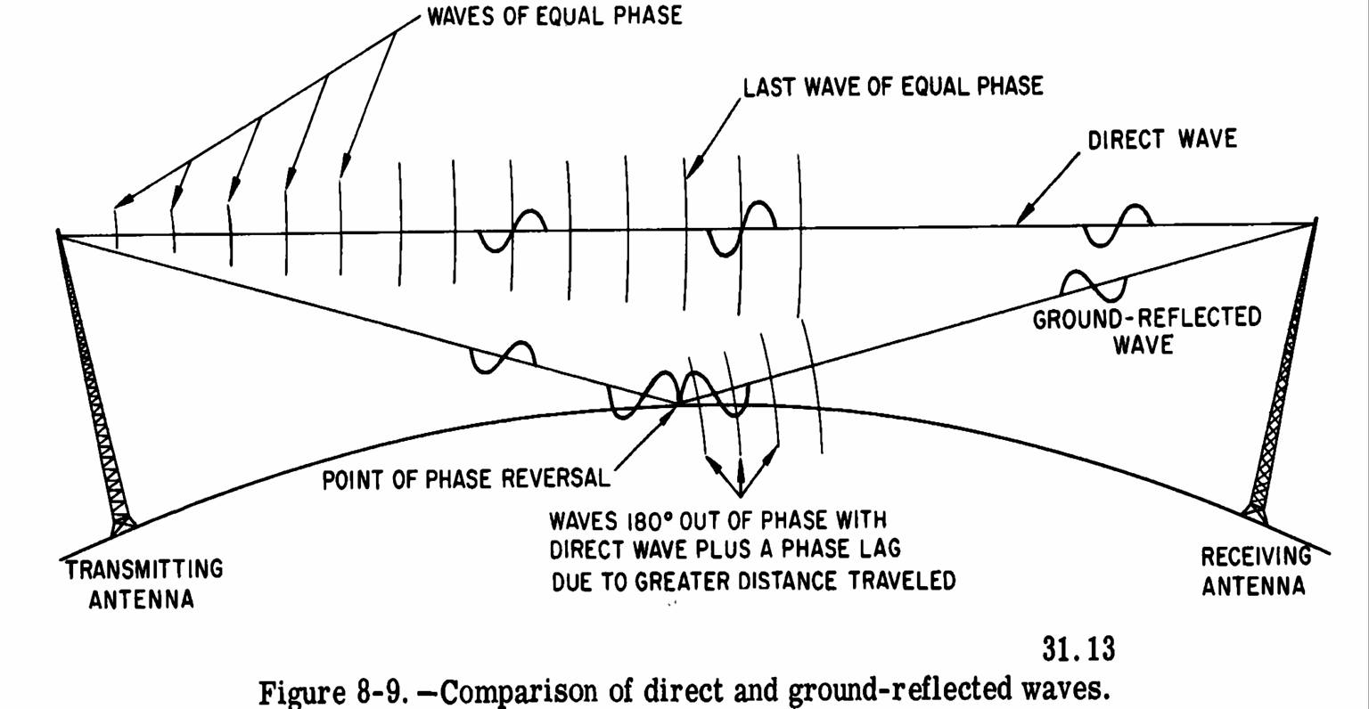
Antenna and Wave Propagation (Chapter Seven)
Communication Dep. 3rd Stage Asst. Lect. Jinan N. Shihab
Diyala University Engineering Collage
Fading occurs, it is due to a large number of waves follow a different number of paths at receiving point.
3- Space Wave Propagation ( Above 30 Mhz):-
It is used at VHF bands ( between 30 MHz- 300MHz), VHF and microwaves and communications like TV, Radar, FM. These utilize this mode of propagation.
In this mode of propagation EM-waves from Tx antenna reach the Rx antenna by two methods:-
directly component
Indirect component(reflections from ground in earth's tropospheric region).
Direct components are the components in which, wave reches directly from transmitting to receiving antenna. Indirect component are the components in which, waves reaches receiving antenna after reflection from the ground, here the phase change of 180⁰ take place.

Slide 8
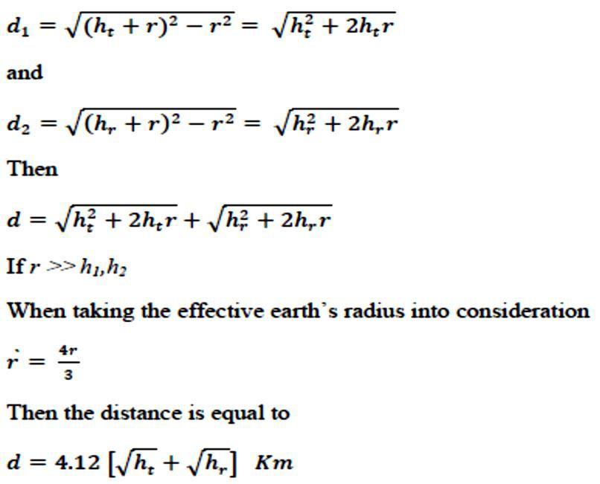
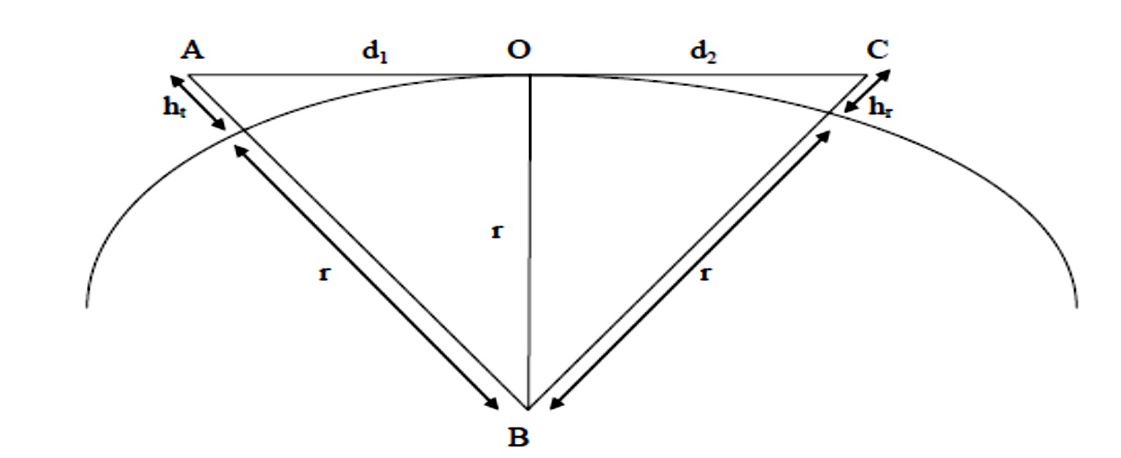
Antenna and Wave Propagation (Chapter Seven)
Communication Dep. 3rd Stage Asst. Lect. Jinan N. Shihab
Diyala University Engineering Collage
1- Line-Of–Sight Propagation (Direct) :-
This mode is called as (line of sight) propagation because at VHF, UHF and microwave frequencies. Line–of–sight is the direct propagation of radio waves between antennas that are visible to each other (the signal that travels the direct path from transmitter to receiver). This is probably the most common of the radio propagation modes. Because radio signals can travel through many non- metallic objects, radio can be picked up through walls. This is still line-of-sight propagation. Example would include propagation between a satellite and ground antenna or reception of television signals from a local TV transmitter.
In space wave propagation, the communication takes place up to or slightly beyond line of sight distance. This distance depends on the height of transmitting antenna is (ht) the height of receiving antenna is (hr).
Let d is the distance between transmitter and receiver, the line of sight:-
d= d1+d2
The radius of earth is approximately 6370 Km at the equator from triangular ABO and triangular CBO as shown in figure below:-
The atmosphere bend horizontal RF waves downward duo to the variation in atmospheric density with height.

Slide 9
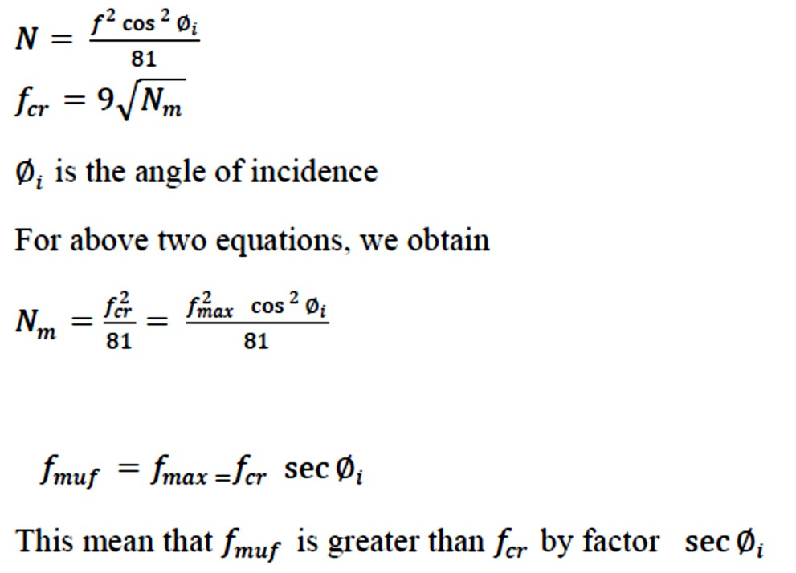
Antenna and Wave Propagation (Chapter Seven)
Communication Dep. 3rd Stage Asst. Lect. Jinan N. Shihab
Diyala University Engineering Collage
This approximation provides a quick method of determining the distance to the radio horizon for each antenna, the sum of which is the maximum LOS propagation distance between the two antennas.
Example: Find the range of LOS system when the receiving and the transmitting antenna
height are 10m, and 100m respectively. Taking the effective earth's radius into consideration.
Solution:-
Critical Frequency
Critical frequency is the highest frequency which can be reflected back to the earth by a particular layer at vertical incident and it is different for different layers. The critical frequency increases during the daylight and decrease at night.
Where:-
𝑓𝑐𝑟is the expressed in MHz, and 𝑁𝑚number of electron per cubic meter.
Maximum Usable Frequency (MUF)
The maximum frequency that can be reflected back to the receiving station from the transmitter for given transmission. This frequency depends upon the angle of incidence and the distance between the transmitting and receiving points and to obtain this frequency. Beyond the MUF, the wave will become a space wave. At MUF the skip zone extends to just short of the receiver. The MUF for a receiver at 1400 miles is 5 MHz. Maximum Usable Frequency is the frequency which can be reflected back to the earth for specific angle of incidence rather than vertical.
𝑓𝑐𝑟=9 √
 | 𝑵_{𝒎}
The maximum usable frequency for a layer is greater than the critical frequency by factor
sec∅𝑖.

Slide 10

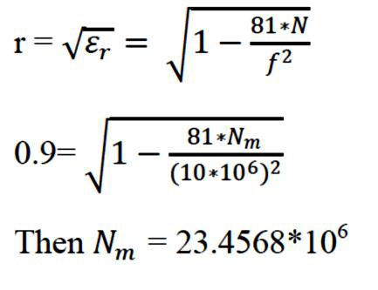
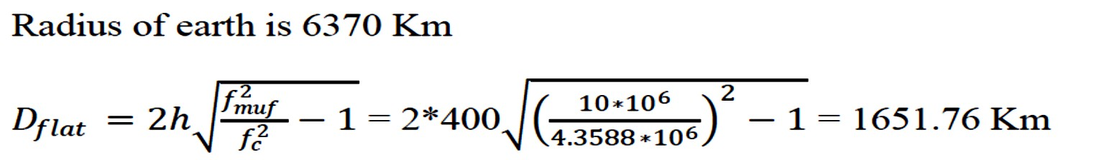
Antenna and Wave Propagation (Chapter Seven)
Communication Dep. 3rd Stage Asst. Lect. Jinan N. Shihab
Diyala University Engineering Collage
Lowest Usable Frequency (LUF)
Which is lowest frequency in the high frequency band that will be satisfactory reception for a given distance and given transmitter power. Lowest usable high frequency (LUHF) depend upon the following factors:
he effective radiated power.
The absorption characteristics of the ionosphere for the path between Tx and Rx.
The required field strength.
Optimum Frequency for Traffic (OFT)
To account for day to day variation within the month the Optimum Traffic (working) Frequency (OTF)
OTF= 0.85fmuf
The maximum distance for communication
The maximum distance that can be covered by a single hop using ionosphere propagation is about 2500 miles. Greater distances can be covered using multi hop propagation, in which radio waves are reflected by the ground back up to the ionosphere. The maximum distance for communication using ionosphere region when consider the earth is flat is:-
When consider the earth is curved the maximum distance for communication using ionosphere region is:-
Example: assume that the reflection takes place at a height of 400 Km and that the maximum density in the ionosphere corresponds to 0.9 refractive index at 10 MHz . what will be the range for which the maximum usable frequency is 10 MHz . take the earth’s curvature into
consideration.
Solution:-

Slide 11
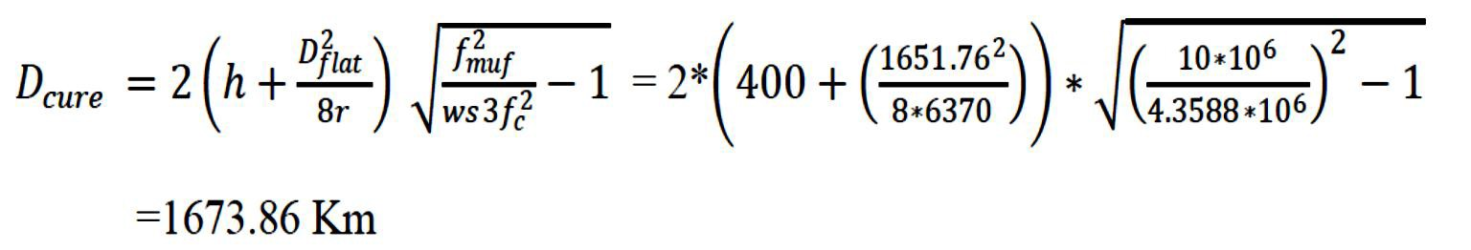

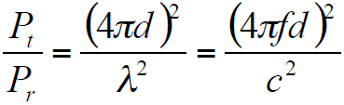

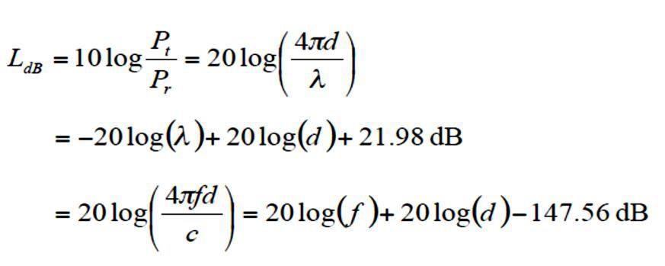

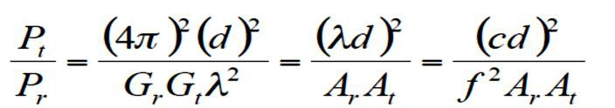

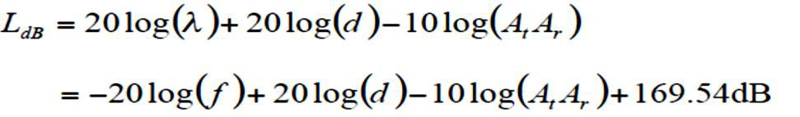
Antenna and Wave Propagation (Chapter Seven)
Communication Dep. 3rd Stage Asst. Lect. Jinan N. Shihab
Diyala University Engineering Collage
Free Space Loss:-
1. Free space loss, ideal isotropic antenna:-
Pt = signal power at transmitting antenna
Pr= signal power at receiving antenna
λ= carrier wavelength
d = propagation distance between antennas
c = speed of light (≈ 3 x 108 m/s)
where d and λare in the same units (e.g., meters)
2. Free space loss equation can be recast:
3. Free space loss accounting for gain of antennas:-
4. Free space loss accounting for gain of other antennas can be recast as:-

